Slide 1
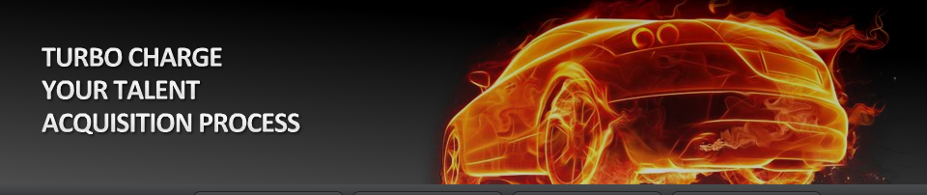
SkillSurvey Pre-Hire 360™
Revolutionized Assessments for Business

Slide 2


From Candidate Perspective – Today’s Approach
Phone interview
I’m a Team Player
Recruiter
Face to Face
Candidate
I interview well
I’m terrific
Resume
Personality / Behavior Assessments
I work really hard, weekends too!
Notes:
How do you vet a candidate. All the background screening (Resume, Interview, Personality Assessments) are typically done and presented in the eyes of the candidate and their perspective.
Of course they will tell you what you want to hear.

Slide 3

From Reference Perspective – Today’s Approach
Phone interview
He’ a Team Player
Recruiter
Face to Face
Reference
He works hard
Resume
He’s terrific
Personality / Behavior Assessments
I would hire him again, yes!
Notes:
References will typically tell you exactly what the candidate tells them to tell you.

Slide 4
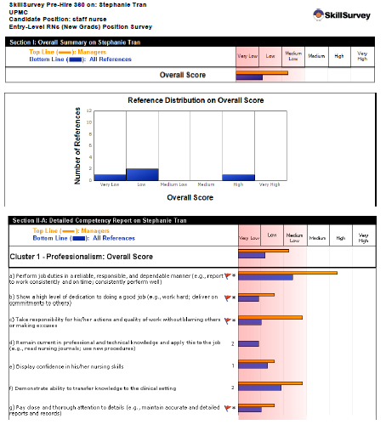
A New Perspective – The New Paradigm
Phone interview
Work Ethic
Recruiter
Face to Face
Dependability
Integrity
Resume
Teamwork
Personality
References
Personality / Behavior Assessments
Interpersonal Skills
Notes:
We still think references are important. But we now survey them, with scientific job related surveys that uncover the keys to
Whether someone will be successful or not. Read off examples of the green boxes. These are typically the reasons people don’t
Succeed at an organization

Slide 5
Current Customer Results Comparison
 | Typical Phone Check | SkillSurvey Reference Assessment
More references | 2 to 3 | 5+ business references 50% of which are former or current Supervisors
Faster | 3 to 5 days | 1 to 2 days
Guide Hiring Managers | No | Previous managers assisting in leading interview
Pauses a hiring decision | < 1% of candidates | 5% - 10% of candidates
Passive sourcing tools | 2-3 on paper or in ATS – not utilized | 5 references per candidate – warm leads
Compliant/Legal Risk | Uncertain/Inconsistent | Supports compliance with EEOC and OFCCP
Science | Results not Validated | Reliability and Validity Studies
Notes:
Ss vs doing it the old fashioned way.
focus on the areas that are important to each organization
Have stats ready for each line item
We are getting 5.5 vs 2-3 references
We are getting 80-85% of references done in 2 working days
Pausing a hiring decision – the numbers are clear – 5% - 8% will have a low score

Slide 6
How SkillSurvey Works…
The Process
Notes:
So that all sounds great .. But how do we do it. How does PreHire 360 give you such actionable information on your candidates?

Slide 7
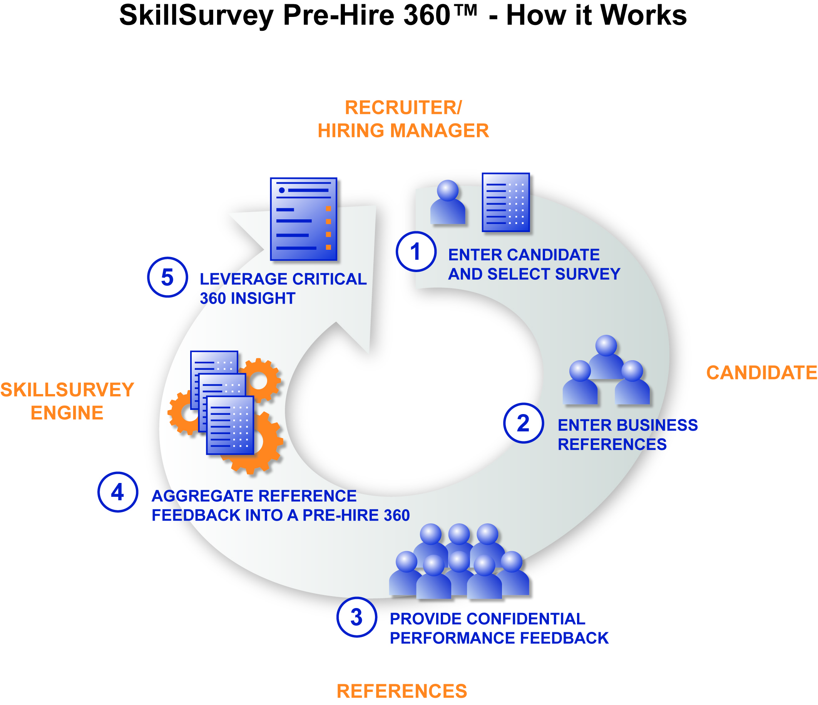
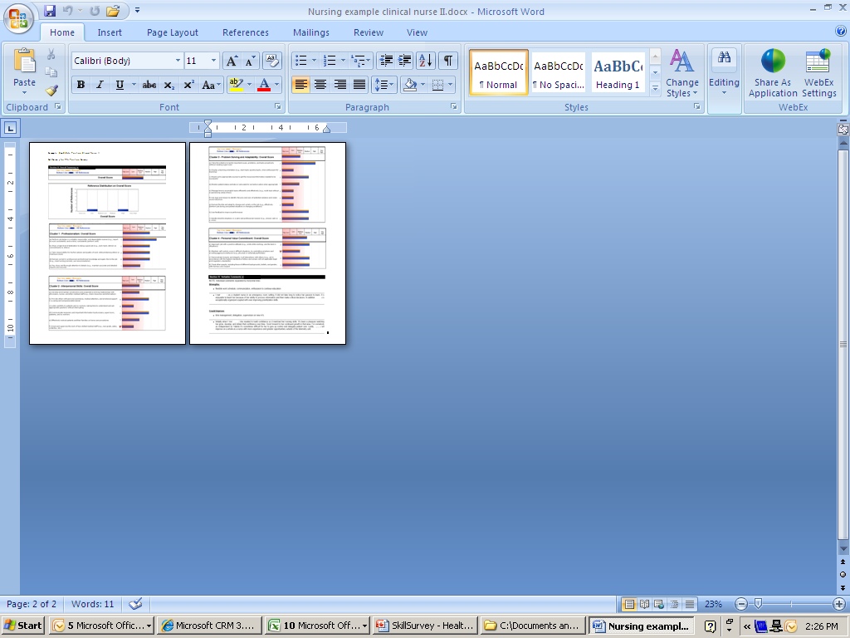
SkillSurvey Process
1 minute
5 minutes
2 seconds
10 minutes

Slide 8
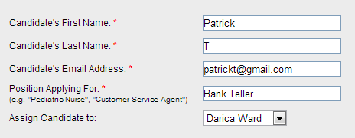
Step 1: Enter Candidate

Slide 9
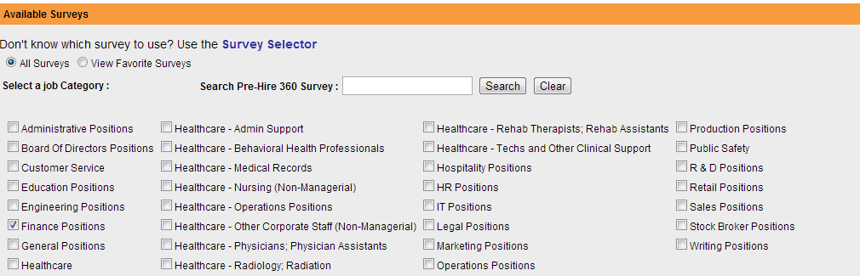
Step 1a: Select Survey

Slide 10
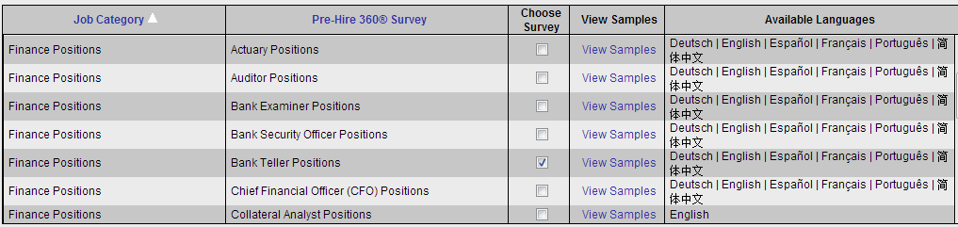
Step 1a: Select Survey and Send Candidate Email
Step 1a: Select Survey
Send email to candidate

Slide 11
Survey Availability
Survey Availability
Job Level ► ▼Job Family | Entry- Level | Hourly | Clerical | Professional | Supervisor | Manager | Executive
General | ✓ | ✓ | ✓ | ✓ | ✓ | ✓ | ✓
Production |  | ✓ | ✓ | ✓ | ✓ | ✓
Sales | ✓ | ✓ | ✓ | ✓ | ✓ | ✓ | ✓
Marketing |  | ✓ | ✓ | ✓ | ✓ | ✓ | ✓
IT | ✓ | ✓ | ✓ | ✓ | ✓ | ✓ | ✓
Operations | ✓ |  | ✓ | ✓ | ✓ | ✓ | ✓
Customer Service | ✓ | ✓ | ✓ | ✓ | ✓ | ✓ | ✓
R&D |  | ✓ | ✓ | ✓ | ✓ | ✓
Admin | ✓ | ✓ | ✓ | ✓ | ✓ | ✓ | ✓
Finance | ✓ |  | ✓ | ✓ | ✓ | ✓ | ✓
Legal | ✓ |  | ✓ | ✓ | ✓ | ✓ | ✓
HR | ✓ |  | ✓ | ✓ | ✓ | ✓ | ✓
Engineering | ✓ |  |  | ✓ | ✓ | ✓ | ✓
Education | ✓ |  |  | ✓ | ✓ |  | ✓
Healthcare | ✓ | ✓ | ✓ | ✓ | ✓ | ✓ | ✓

Slide 12
Step 2: Candidate Enters References
From: Org name Recruiting Sent: Tuesday, February 4, 2013 To: Patrick T Subject: Org name Reference Steps
English | Deutsch | Español | Français | Português | 繁體中文 Dear Patrick, Thank you for your continued interest in the Bank Teller position with Org name. As already explained to you, a critical step in the selection process is reference checking. Org name uses web-based reference checking for this purpose. Please click on the link below. It will open a web page where you will input your references. You will also be able to review a sample of the questions being asked and the email that will be sent to your references. Your references will be emailed a reference survey and their responses will be submitted directly back to SkillSurvey, Inc.. No one will see your references' individual responses because all responses are electronically aggregated together to produce one summary report. Note that all references will be responding as individuals, not as representatives of any company or organization. Please click or paste this link into your browser: http://uat-eref.skillsurvey.com/?k=i7323118 Need help?
Frequently Asked Questions: http://uat-eref.skillsurvey.com//SS.WebUI.FAQ/Candidate_FAQ.aspx?PrtID=1 Technical support: customerservice@skillsurvey.com
Candidate is offered option to continue in preferred language

Slide 13
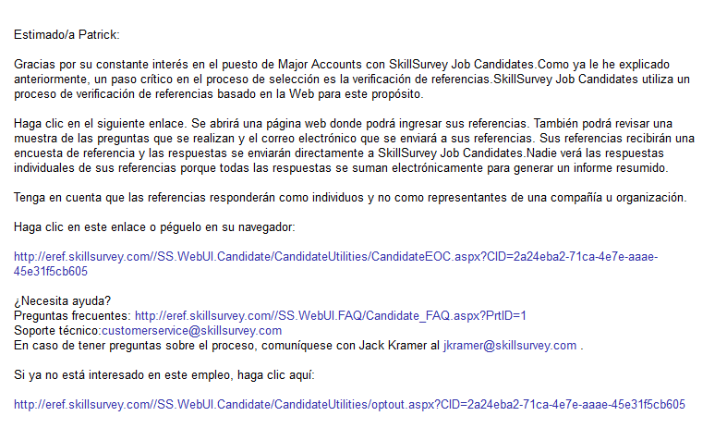
Sample of Candidate Email in Spanish

Slide 14
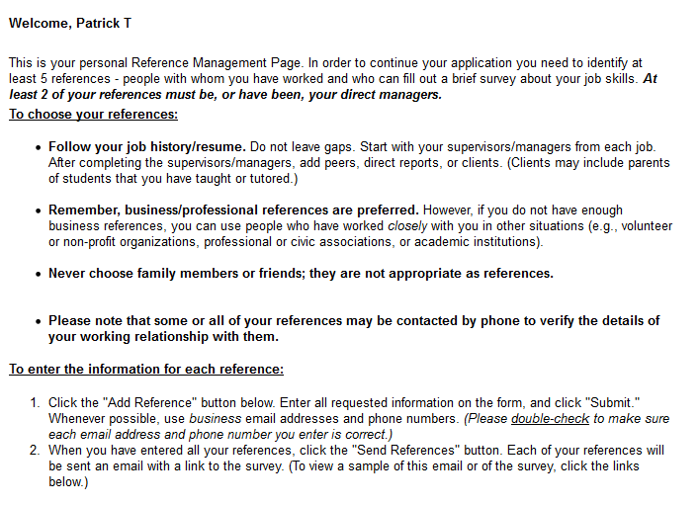
Step 2b: Candidate Inputs References

Slide 15
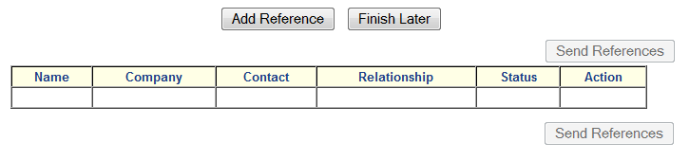
Step 2b: Candidate Inputs References

Slide 16
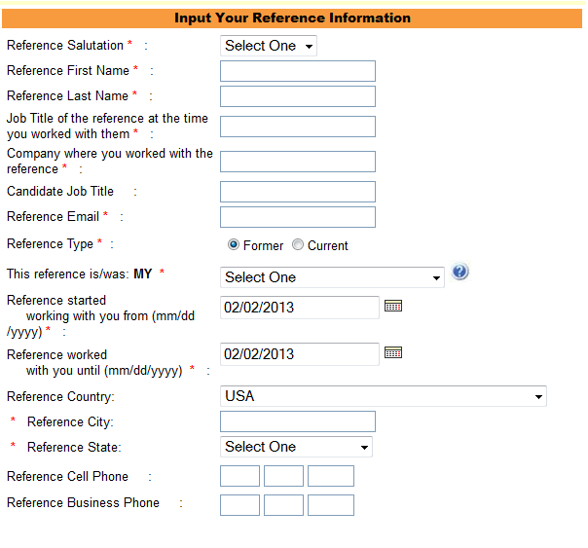
Step 2b: Candidate Inputs References

Slide 17
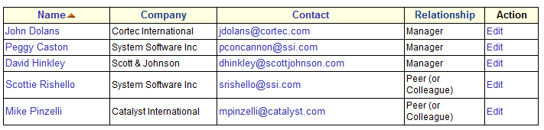
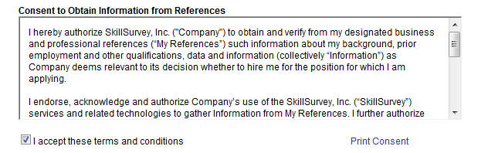
Step 2c: Candidate Confirms References and Signs Legal Waiver
Step 2b: Candidate Inputs References
Proof of Consent
“…I hereby release any such person, their company, and any affiliated officers, directors, agents, and employees from any and all claims I may have arising out of the disclosure of such information…”

Slide 18
Step3a: Automated Email Sent to All References
From: Patrick T Sent: Thursday, February 2, 2013 To: Scott Davies Subject: Patrick T Reference Request
Dear Scott Davies,
I am pursuing a professional development opportunity and I'd like to use you, as well as several other individuals, as a professional reference. All you need to do is complete a short (less than 30 questions), confidential, web-based survey regarding my skills.
No one will see your individual responses because the system averages the responses from all of my references together to produce one summary report. To further ensure confidentiality, no report will be produced unless at least 3 people respond.
Please note that you will be responding as an individual, not as a representative of any company or organization. Also, I have executed a legally binding agreement that releases you as well as any organization with which you are now affiliated or have been affiliated in the past, from any potential liability for providing this information. The process is quick and easy. Please click on the following link to begin: http://eref.skillsurvey.com/SS.WebUI/RefSurveyDetails.aspx? Thank you for your time, Patrick T

Slide 19
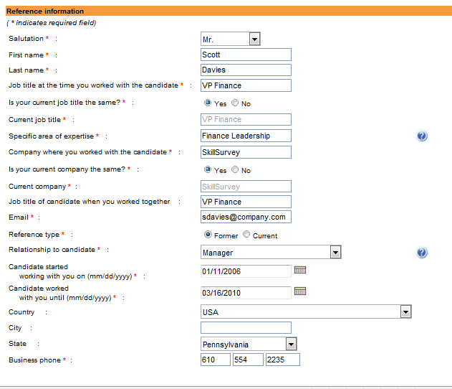
Step3a: Automated Email Sent to All References
Dear Scott Davies,
Thank you for taking the time to respond to Patrick T’s reference request. Before you take the survey, please take a moment to review the information in the form below. If any information is incorrect, please select the appropriate field and make the desired changes. When you are finished, click the continue button at the bottom of the page to save your changes and access the reference survey.

Slide 20
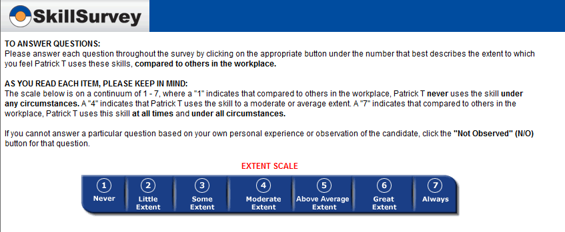
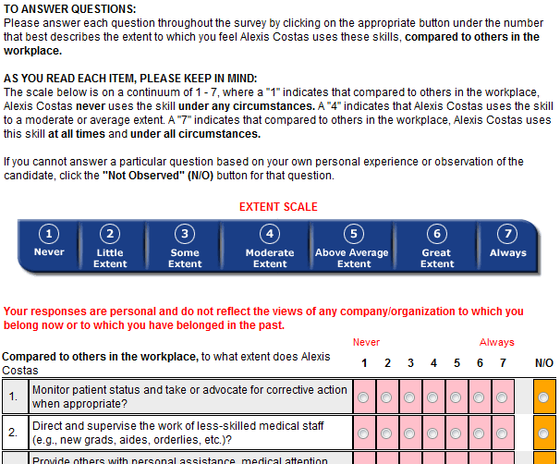
The Surveys: Job-Specific, Behaviorally-Based Questions
The Surveys: Job-Specific, Behaviorally-Based Questions

Slide 21
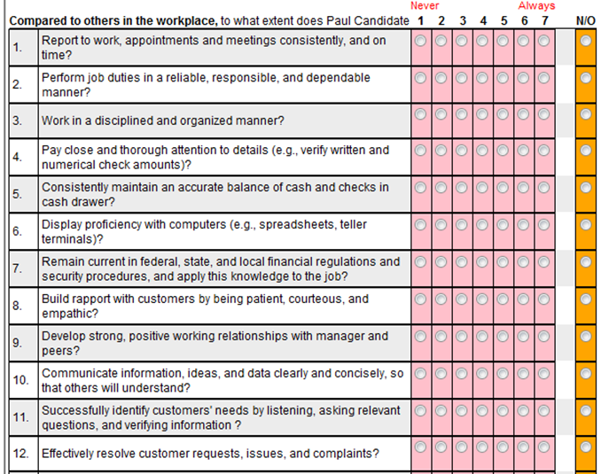
Complete Survey, Verbatim Comments, Passive Sourcing
Notes:
The survey slide shows the top of the survey. Easy description of the scale. 1 is never, 7 always observed. We also provide a “not observed” choice.
The body of the survey is displayed – discuss how quick and easy. Most questions between 20-25 questions. Once completed, we ask for top 3 strengths and top areas where they could improve. We also pop up the opt out option – if they don opt out, we can present the reference with a link that takes them directly to the prospects career page. We copy the page and add as animation.
This tool helps in 3 ways. It rules people out –avoid bad hire. It confirms decision to hire. It rules people in. At IT firm, they hire people who are shy, nervous etc and don’t interview well but have tremendous technical skills.
91% of referees spend time online to fill in free form information. Applicants don’t have access to the report. Typically, they don’t sit on the old traditional calls and have access to recruiter or hiring managers notes, so why show them the report

Slide 22
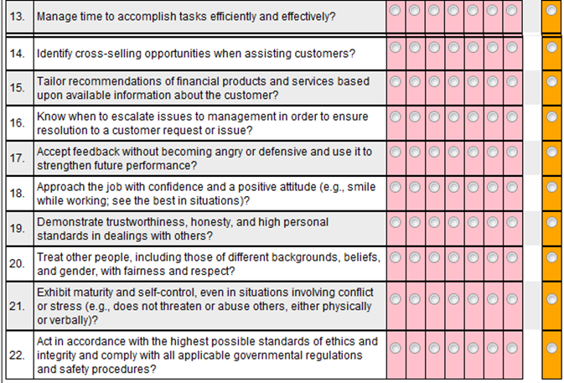
Complete Survey, Verbatim Comments, Passive Sourcing
Notes:
The survey slide shows the top of the survey. Easy description of the scale. 1 is never, 7 always observed. We also provide a “not observed” choice.
The body of the survey is displayed – discuss how quick and easy. Most questions between 20-25 questions. Once completed, we ask for top 3 strengths and top areas where they could improve. We also pop up the opt out option – if they don opt out, we can present the reference with a link that takes them directly to the prospects career page. We copy the page and add as animation.
This tool helps in 3 ways. It rules people out –avoid bad hire. It confirms decision to hire. It rules people in. At IT firm, they hire people who are shy, nervous etc and don’t interview well but have tremendous technical skills.
91% of referees spend time online to fill in free form information. Applicants don’t have access to the report. Typically, they don’t sit on the old traditional calls and have access to recruiter or hiring managers notes, so why show them the report

Slide 23
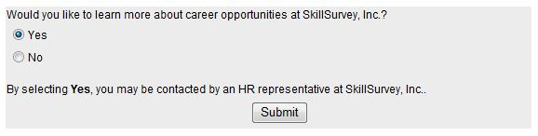
Complete Survey, Verbatim Comments, Passive Sourcing
Would you like to learn more about current job openings at org name
By selecting Yes, you may be contacted by an HR representative from org name
Notes:
The survey slide shows the top of the survey. Easy description of the scale. 1 is never, 7 always observed. We also provide a “not observed” choice.
The body of the survey is displayed – discuss how quick and easy. Most questions between 20-25 questions. Once completed, we ask for top 3 strengths and top areas where they could improve. We also pop up the opt out option – if they don opt out, we can present the reference with a link that takes them directly to the prospects career page. We copy the page and add as animation.
This tool helps in 3 ways. It rules people out –avoid bad hire. It confirms decision to hire. It rules people in. At IT firm, they hire people who are shy, nervous etc and don’t interview well but have tremendous technical skills.
91% of referees spend time online to fill in free form information. Applicants don’t have access to the report. Typically, they don’t sit on the old traditional calls and have access to recruiter or hiring managers notes, so why show them the report

Slide 24
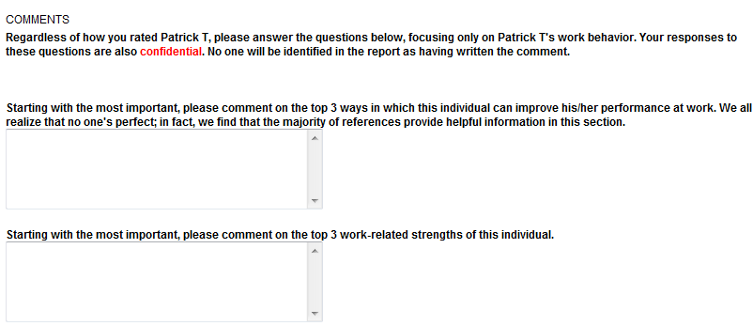
Complete Survey, Verbatim Comments, Passive Sourcing
Notes:
The survey slide shows the top of the survey. Easy description of the scale. 1 is never, 7 always observed. We also provide a “not observed” choice.
The body of the survey is displayed – discuss how quick and easy. Most questions between 20-25 questions. Once completed, we ask for top 3 strengths and top areas where they could improve. We also pop up the opt out option – if they don opt out, we can present the reference with a link that takes them directly to the prospects career page. We copy the page and add as animation.
This tool helps in 3 ways. It rules people out –avoid bad hire. It confirms decision to hire. It rules people in. At IT firm, they hire people who are shy, nervous etc and don’t interview well but have tremendous technical skills.
91% of referees spend time online to fill in free form information. Applicants don’t have access to the report. Typically, they don’t sit on the old traditional calls and have access to recruiter or hiring managers notes, so why show them the report

Slide 25
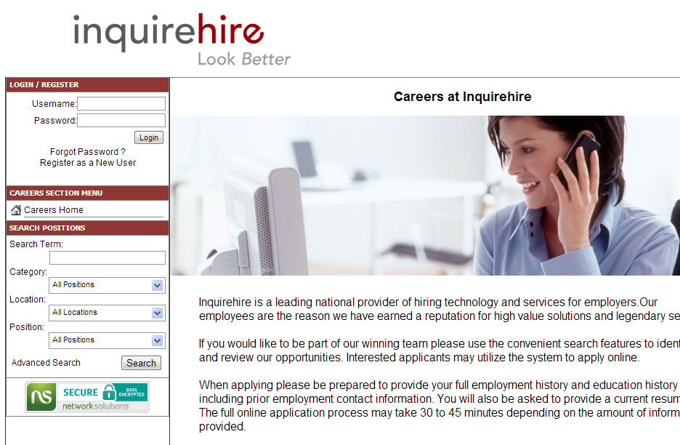
Drive Warm Candidates to Career Page

Slide 26
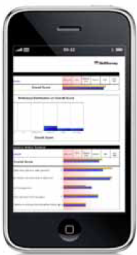
SkillSurvey Goes Mobile
SkillSurvey Mobile
On-the-go access anytime, anywhere
Use your iPhone, BlackBerry, Droid, or Windows-enabled Smartphone
No hassle for recruiters, candidates, or references
Faster turnaround time for all job candidates
4.6% of all job candidates use a mobile device
Those using a mobile device respond 38% faster

Slide 27
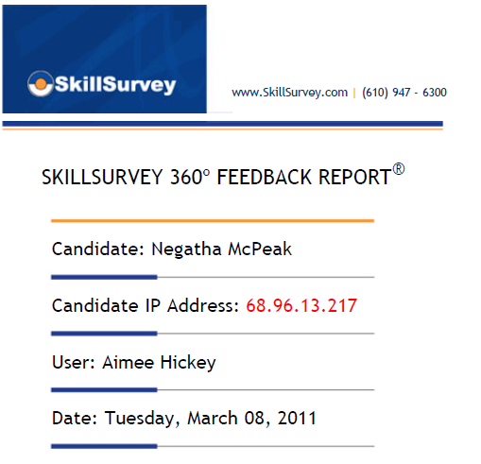
Step 4: Aggregate Reference Responses into Actionable Intel
Notes:
We then present the survey to the hiring team.

Slide 28
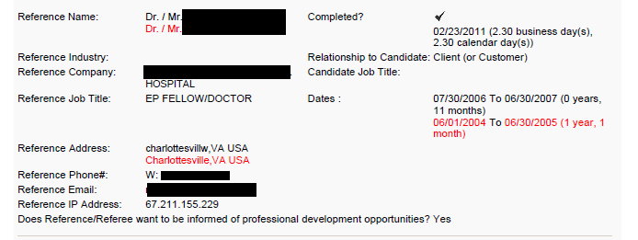
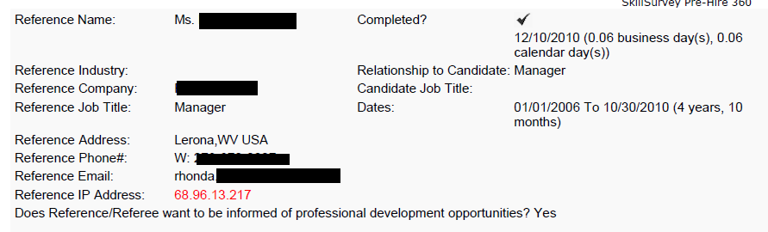
Step 4: Aggregate Reference Responses into Actionable Intel
Reference Information Corrected

Slide 29
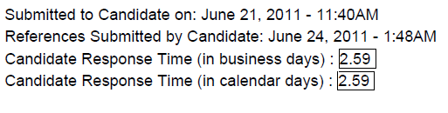
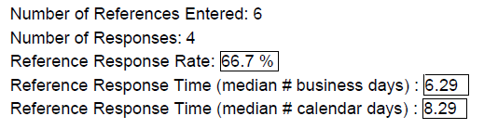
Predicting Outcome - Responsiveness
Candidate Response Data
Reference Response Data

Slide 30
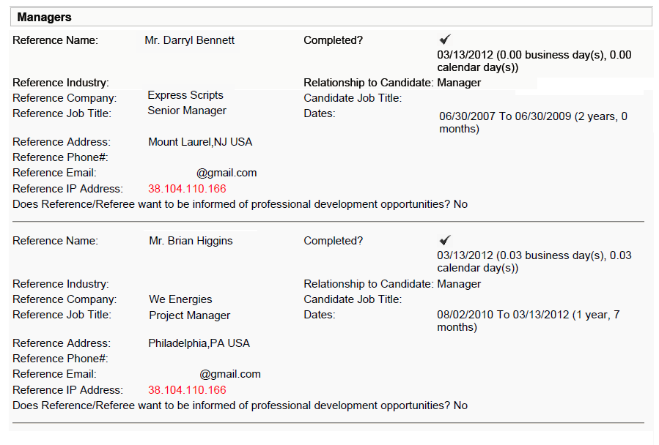
Authenticity - Potential Red Flags-Spot Fake References
Matching IP address from references employed by different companies indicate both references used the same computer. This indicates the candidate may have falsified the references.
Notes:
30

Slide 31
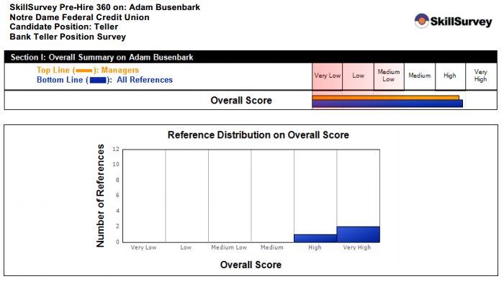
Validated Candidate – Good Fit

Slide 32
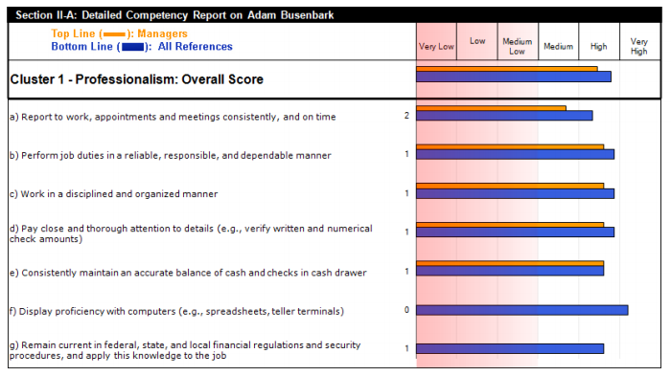
Validated Candidate – Good Fit

Slide 33
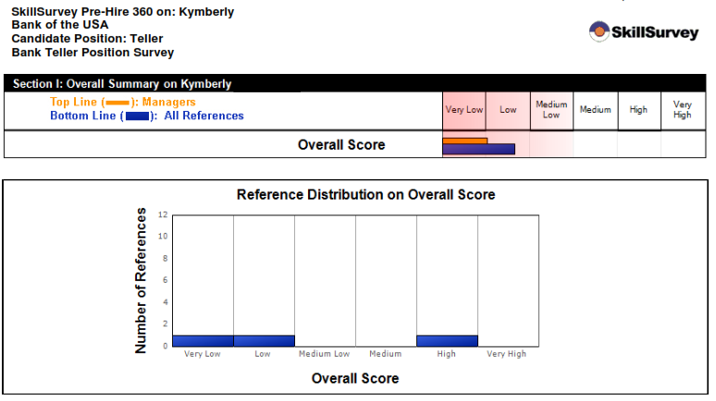
Pause or Avoid this Candidate – Low Scoring

Slide 34
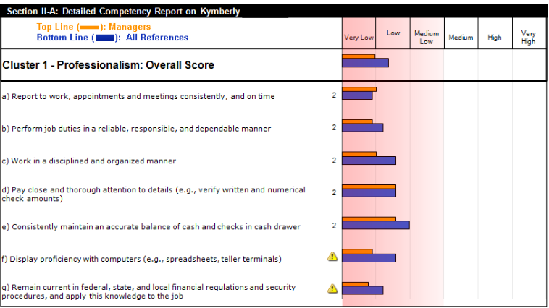
Professionalism
Notes:
Highlight the quota issue that all sales people run into in cluster 1

Slide 35
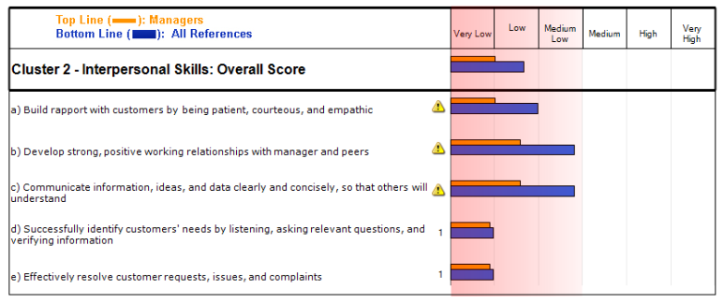
Interpersonal Skills
Notes:
This is where the references are telling a story. The two points highlighted are about communication and teamwork. Building relationships both internally and externally with customers. The verbatim comments will support these points but don’t mention that yet.

Slide 36
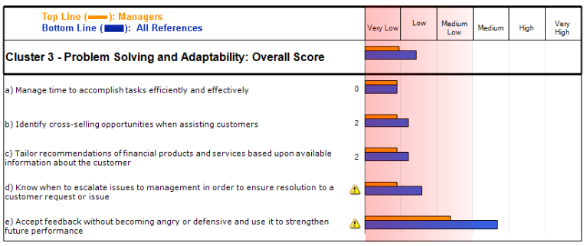
Problem Solving and Adaptability

Slide 37
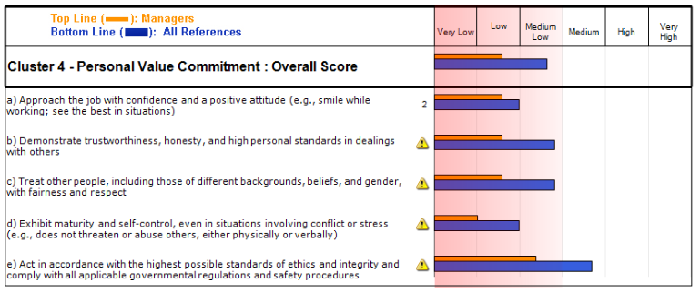
Personal Values

Slide 38
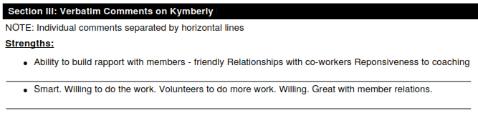
Verbatim Comments

Slide 39
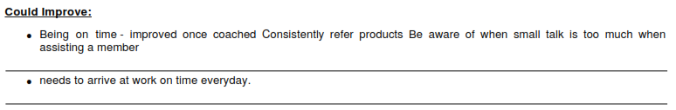
Verbatim Comments
Notes:
Now here is the story. Highlighted the team work issue, ability to get along with others. Work alone, demanding of teammates. Get po and run from customers. Point 4 – temper – he has one. They told the story. So if working on teams is important and long term relationships with customers is key, this isnt the right guy.

Slide 40
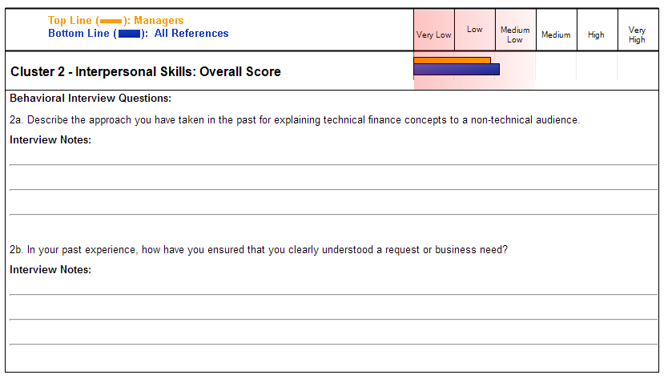
Behavioral Interview Questions – Guide the Interview

Slide 41
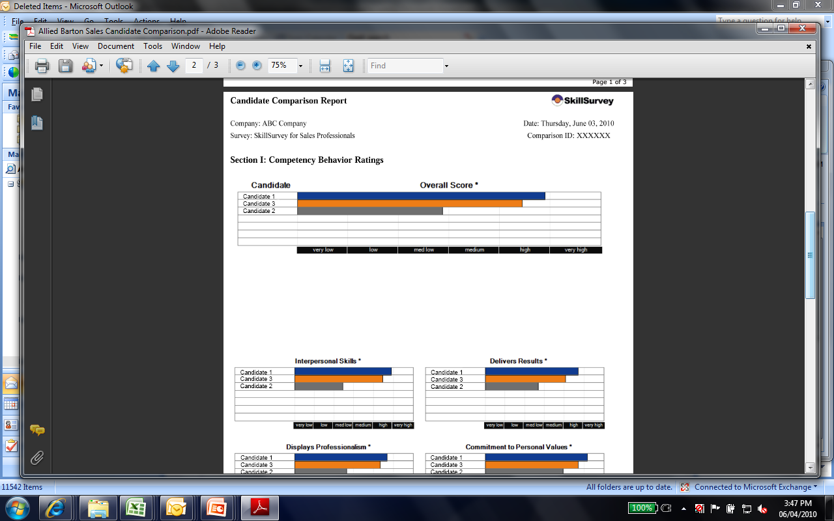
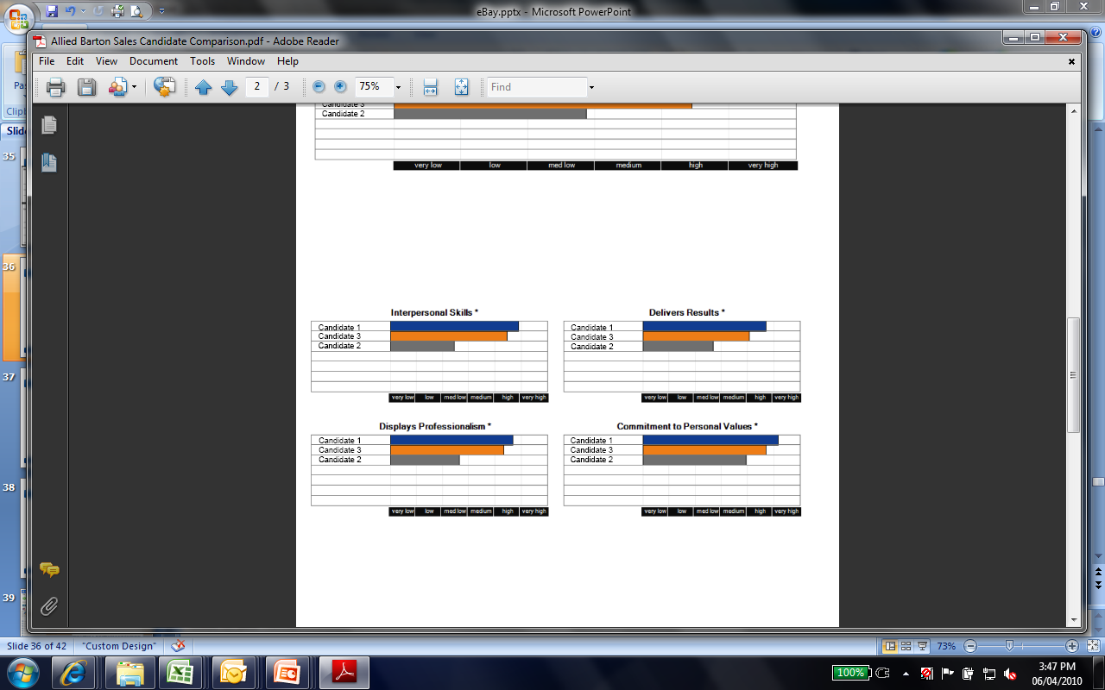
Candidate Comparison Report

Slide 42
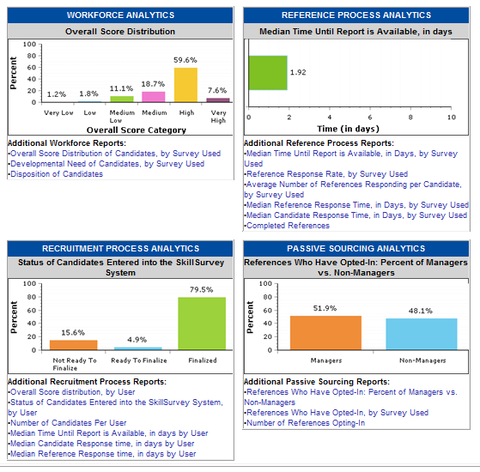
Business Intelligence Dashboard

Slide 43
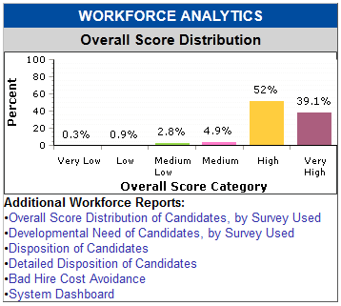
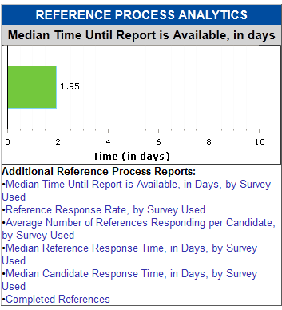
Business Intelligence – Detailed On-Demand Analytics

Slide 44
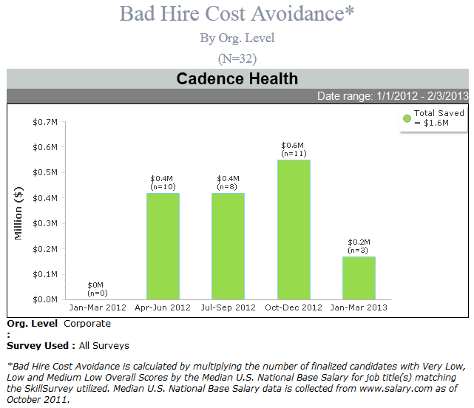
The Cost of Not Avoiding

Slide 45
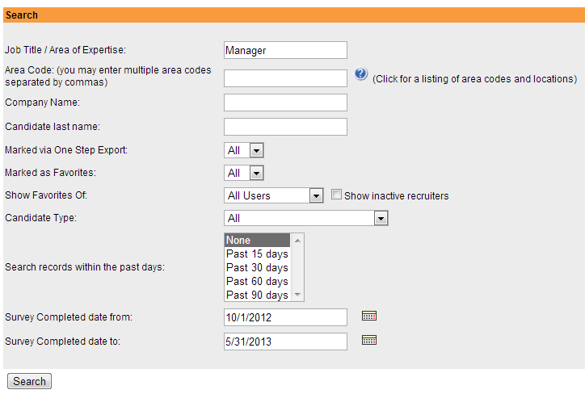
Passive Candidate Compiler

Slide 46
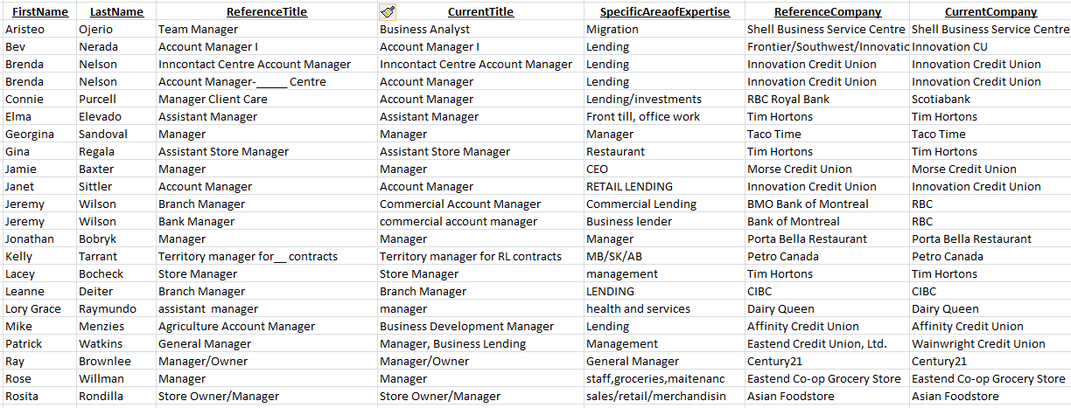
Passive Candidate Compiler

Slide 47
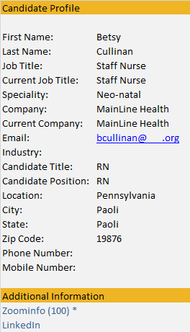
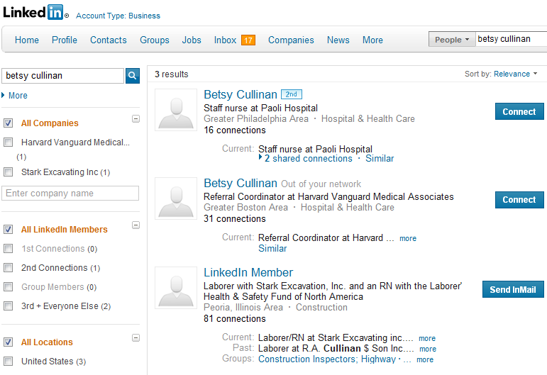
Integrated Link to LinkedIn, Zoom info

Slide 48

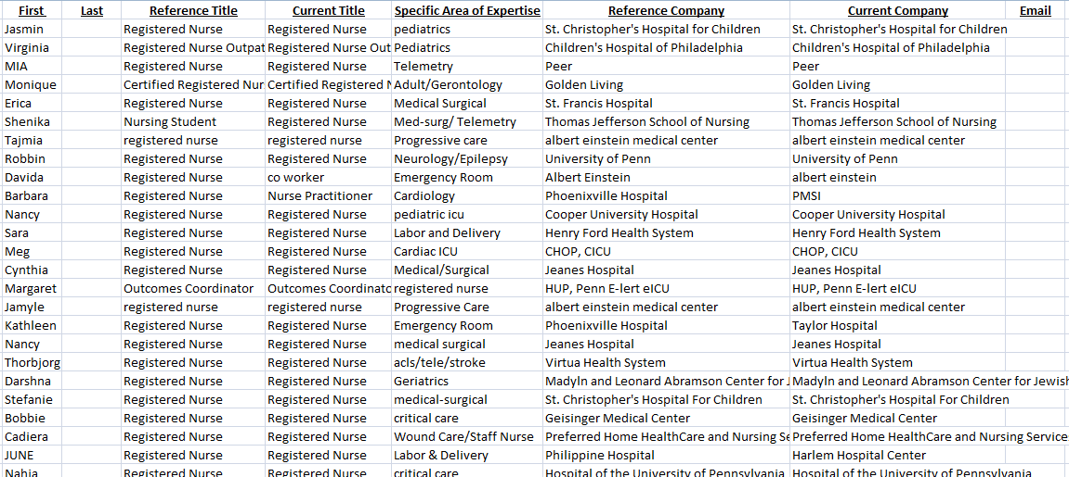
Passive Candidate Compiler To the Q – Next Generation

Slide 49

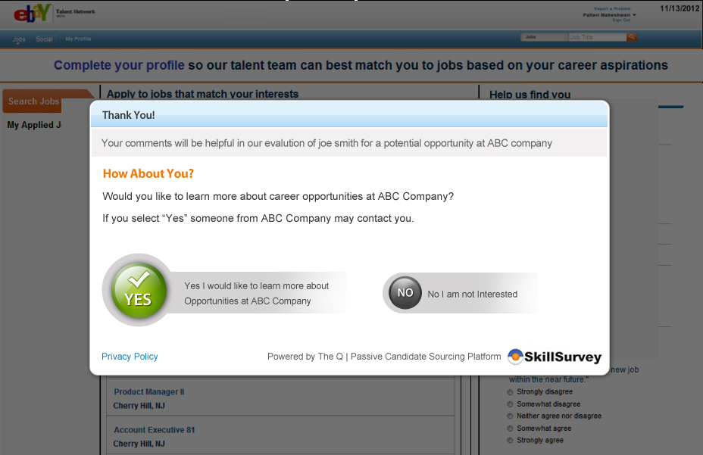





Passive Candidates Move to Active – The Q
Let’s Talk…
Reference
Turned
Candidate
Recruiter

Slide 50
The Q
References will now be able to become active members of a company’s talent network
Share their professional profiles
Clarify their current employment situation to help recruiters determine how active or passive a person is in their job search
See current job openings at a company that “match” their work experience
New SkillSurvey science helps recruitment teams identify those passive candidate references that best match open positions
Notes:
Our goals with The Q are:
To provide a the reference with the ability to share information about themselves in a private way with a company that they’d be interested in learning more about
When a reference becomes an active member of a company’s talent network, they are able to share professional profiles, give indication as to how actively or passively they are searching for a new job, and view and apply for current job openings that match their experience
For recruiters, they are getting a passive pool of high quality talent that directly expressed interest in hearing about opportunities at their company. At the same time, SkillSurvey’s science matches references against open positions to provide the recruiter with recommendations.

Slide 51
References Become Candidates in The Q™
After completing a reference assessment, the reference can select to learn more about opportunities at org name
Notes:
So, briefly, how does it work.
After a reference completes a Pre-Hire 360 survey they become active members of The Q and are presented with the ability to easily and automatically build a profile.
Once in, the reference will see suggested jobs, have the ability to search through openings, and can apply for positions.

Slide 52

References Become Candidates in The Q
…Or they can manually enter a profile, create a profile later, or just start searching job listings
Candidates can create profiles by uploading a resume and having it parsed
Notes:
So, briefly, how does it work.
After a reference completes a Pre-Hire 360 survey they become active members of The Q and are presented with the ability to easily and automatically build a profile.
Once in, the reference will see suggested jobs, have the ability to search through openings, and can apply for positions.

Slide 53

Candidate’s Home Page
See level of profile completeness
Steps to complete profile
View matching jobs
Understand how active or passive a candidate is
Notes:
The recruiter also gets a home page to view any recently joined candidates along with a temperature indicator telling them how active or passive they are. It also provides insights on who is most active in the network, any candidates recently referred, open jobs the recruiter is sourcing with candidate job fits and a portal for recruiter collaboration.
Recruiters can also invite contacts from passive candidate pools like facebook, twitter, etc.

Slide 54

Recruiter’s Talent Network Home Page
View recently joined candidate profiles
See who’s active in your network
See referred candidates
Invite contacts from passive candidate pools
Manage open jobs with candidate fits
Notes:
The recruiter also gets a home page to view any recently joined candidates along with a temperature indicator telling them how active or passive they are. It also provides insights on who is most active in the network, any candidates recently referred, open jobs the recruiter is sourcing with candidate job fits and a portal for recruiter collaboration.
Recruiters can also invite contacts from passive candidate pools like facebook, twitter, etc.

Slide 55
Getting Started…
NO Project Planning
NO Long Term Project Management
Ready
1 hour virtual set-up session
Set
2 hour virtual training session
Go
Start entering candidates
Build your talent pool
Notes:
So we have this terrific solution. Now what? Simple to get started. Template for your business. Quick start up and training. No long term projects, costly and time consuming endeavors.

Slide 56
Why org name and SkillSurvey?
Impact Quality of Hire
Reduce Turnover
Support Hiring Managers Interview Effectiveness
Improve Efficiency
Improve Patient Satisfaction Scores
Improve Passive Sourcing
Drive Compliance and Consistency

